Slide 1
Big Data Project Tourism Trend Analysis
Submitted By
Sai Swaroop G24AI1026
Mugundhan B G24AI1051
Rodda Sree Charan Reddy G24AI1095
Indian Institute of Technology Jodhpur

Slide 2
Introduction to the Project
This project focuses on analyzing large-scale geo-tagged tourism data.
The aim is to uncover tourism trends, seasonal patterns, and emerging hotspots.
We leveraged JSON from Indian Tourism sources.
Built a cloud-native big data pipeline and interactive dashboards.

Slide 3
Problem Statement
Tourism boards lack real-time data on visitor trends..
Traditional methods fail to capture fast-changing tourist behavior.
Need for scalable, automated insights from modern data sources like social media.

Slide 4
Objectives
Collect tourism-related data from open sources & mock APIs
Process and clean data using PySpark & Databricks
Build pipeline on Azure (ADF + Event Hub + Data Lake)
Perform analytics (monthly trends, state-wise analysis)
Build interactive dashboards using Power BI

Slide 5
Technology Stack
Azure Services: Event Hub, ADF, Blob Storage, Data Lake Gen2, Databricks
Data Processing: PySpark, Pandas
Visualization: Power BI
Dataset: JSON from Indian Tourism sources

Slide 6
Data Exploration and Cleaning
Null checks, type corrections, time conversion
Duplicate removals, activity-based filtering
Key Feature Engineering:
Extracting year/month
Categorizing into tourism seasons (Winter, Summer, Monsoon)

Slide 7
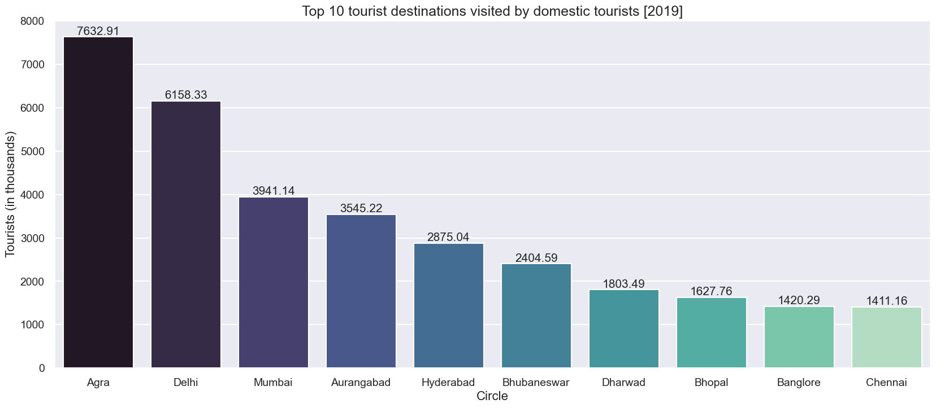
Exploratory Data Analysis
Monthly tourism trend: Clear peaks in December and May
Top visited states: Agra, Delhi, Mumba
Activity preferences: Sightseeing, Shopping, Religious visits

Slide 8
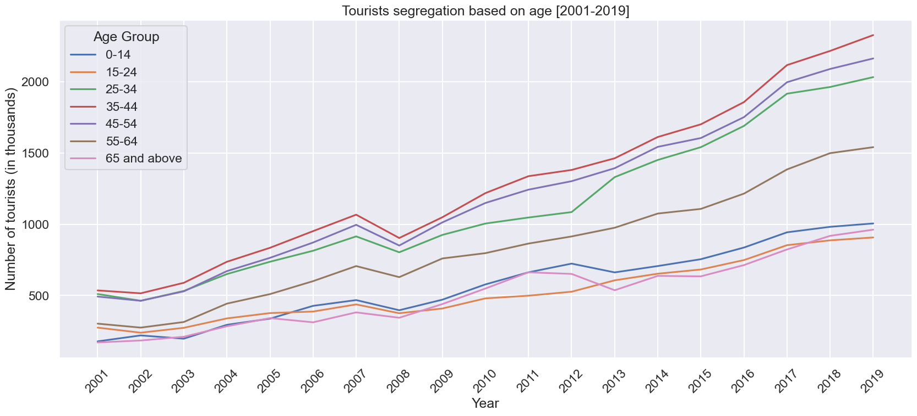
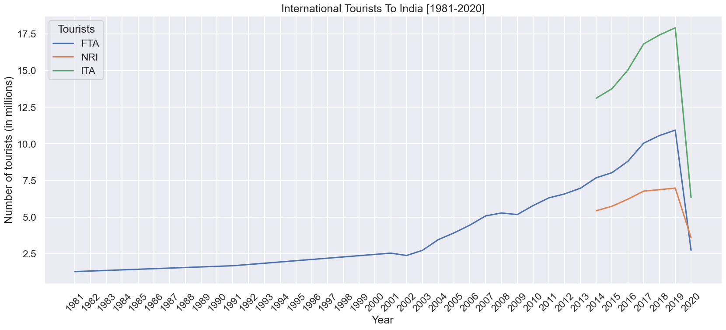
Exploratory Data Analysis

Slide 9
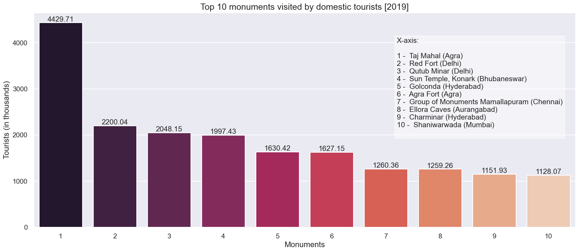
Exploratory Data Analysis
Clustering of coordinates using KMeans (PySpark)
Region-wise heatmap visualization
Identifying popular tourist hubs from coordinate data

Slide 10
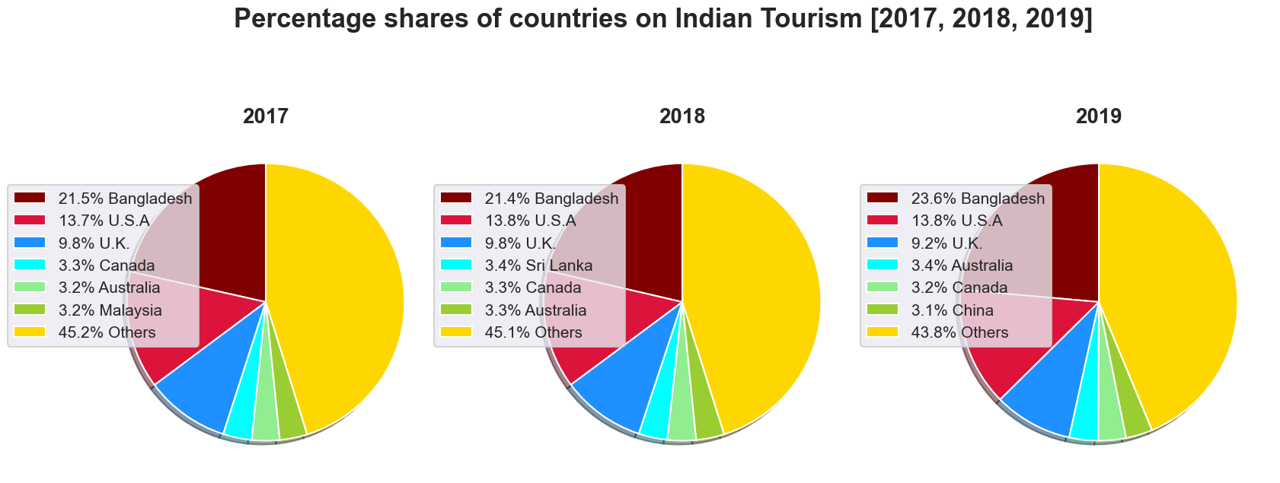
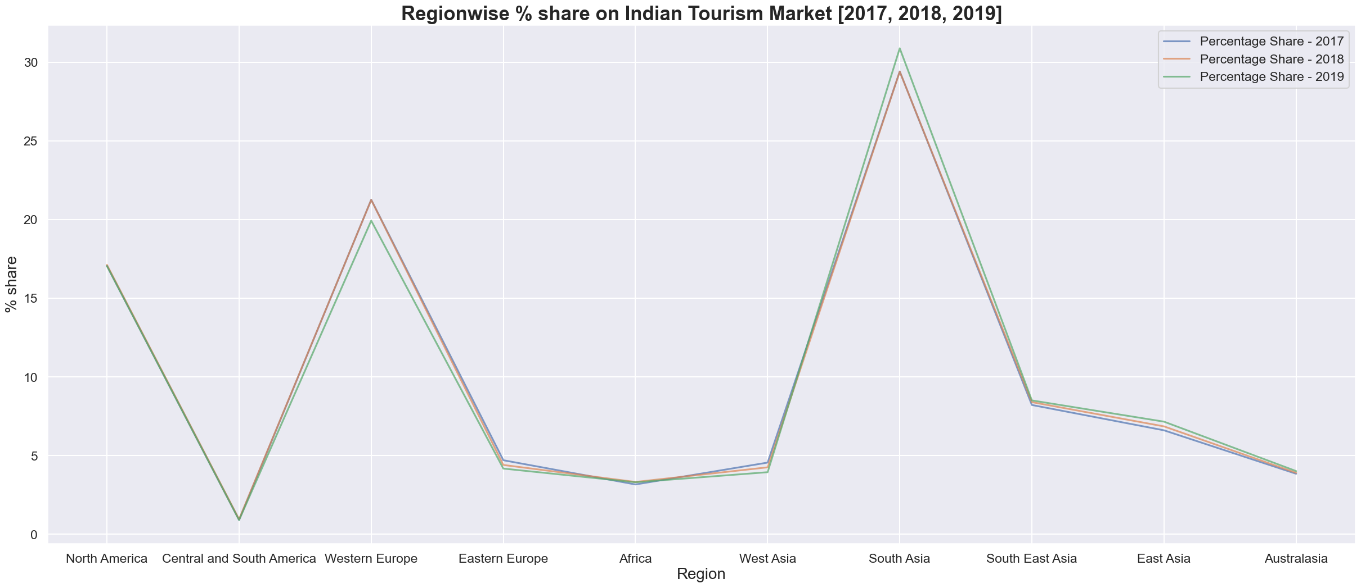
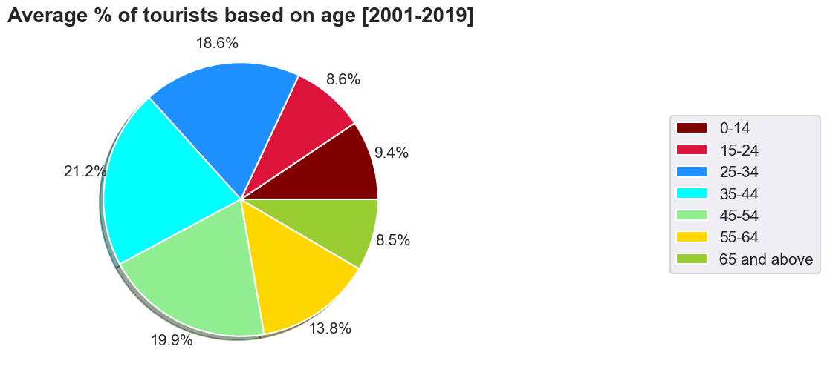
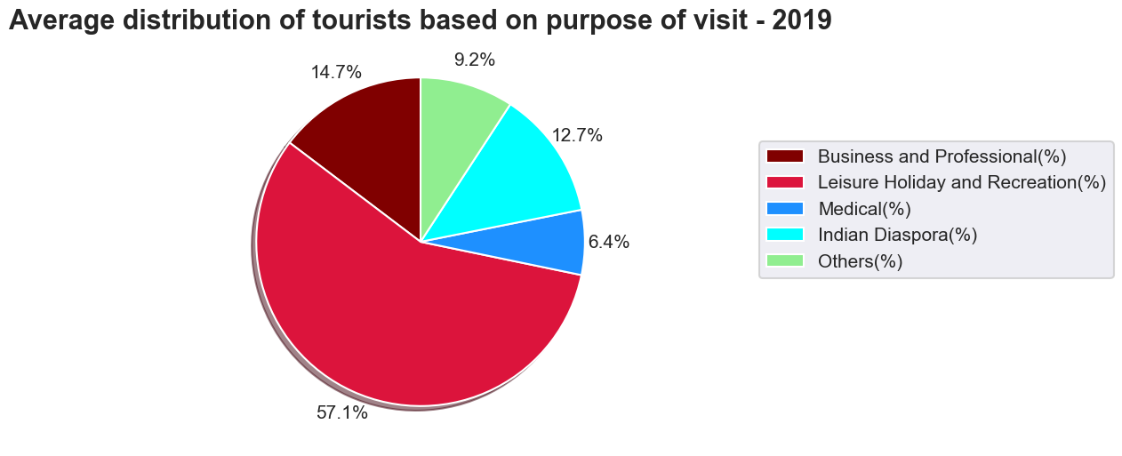
Exploratory Data Analysis

Slide 11
Azure Pipeline Architecture
Step 1: Web Activity – Trigger tourism API fetch
Step 2: Store JSON in Azure Blob / Data Lake
Step 3: Databricks notebook – Transform data using PySpark
Step 4: Store back into refined folder
Step 5: Power BI dashboard connected to refined zone

Slide 12
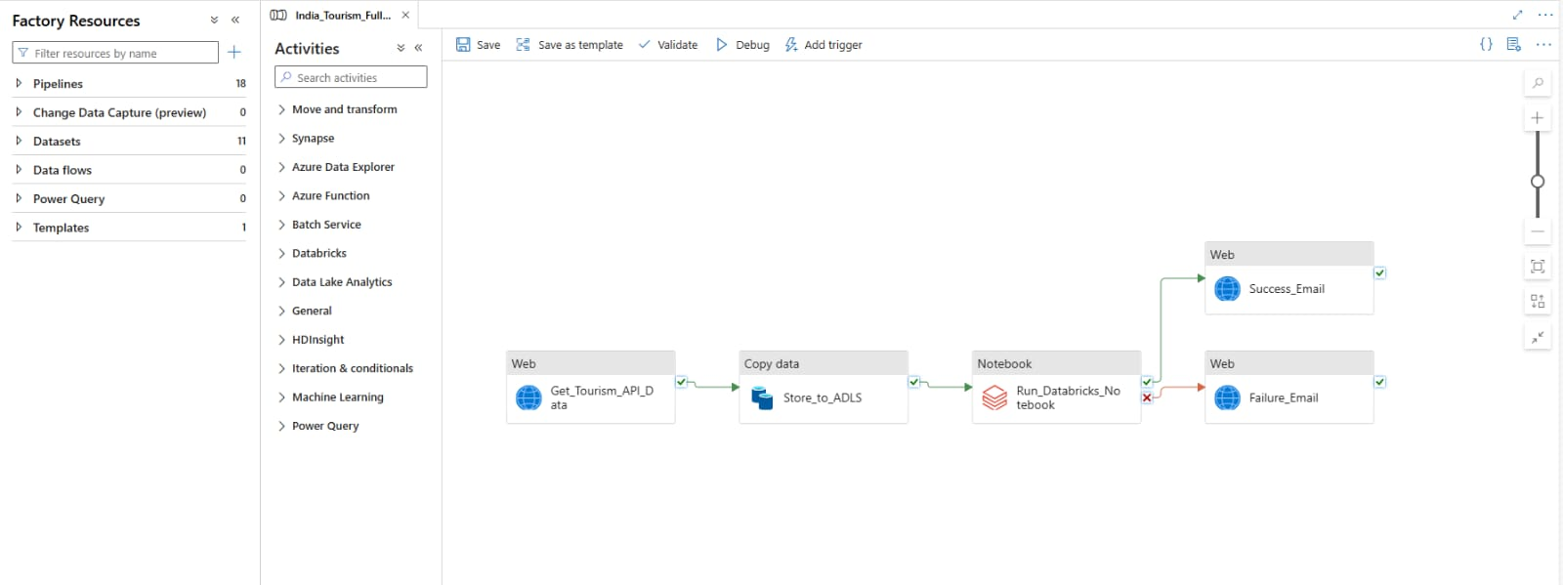
Azure Data Factory Implementation
Multiple pipelines:
Source pipeline
Databricks trigger
Email notification on failure
Parameters used: filenames, date ranges

Slide 13
Databricks Notebook & Code Logic
PySpark operations:
Read JSON from lake
Perform feature extraction & transformations
Save cleaned data as CSV
Notebook executed from ADF pipeline

Slide 14
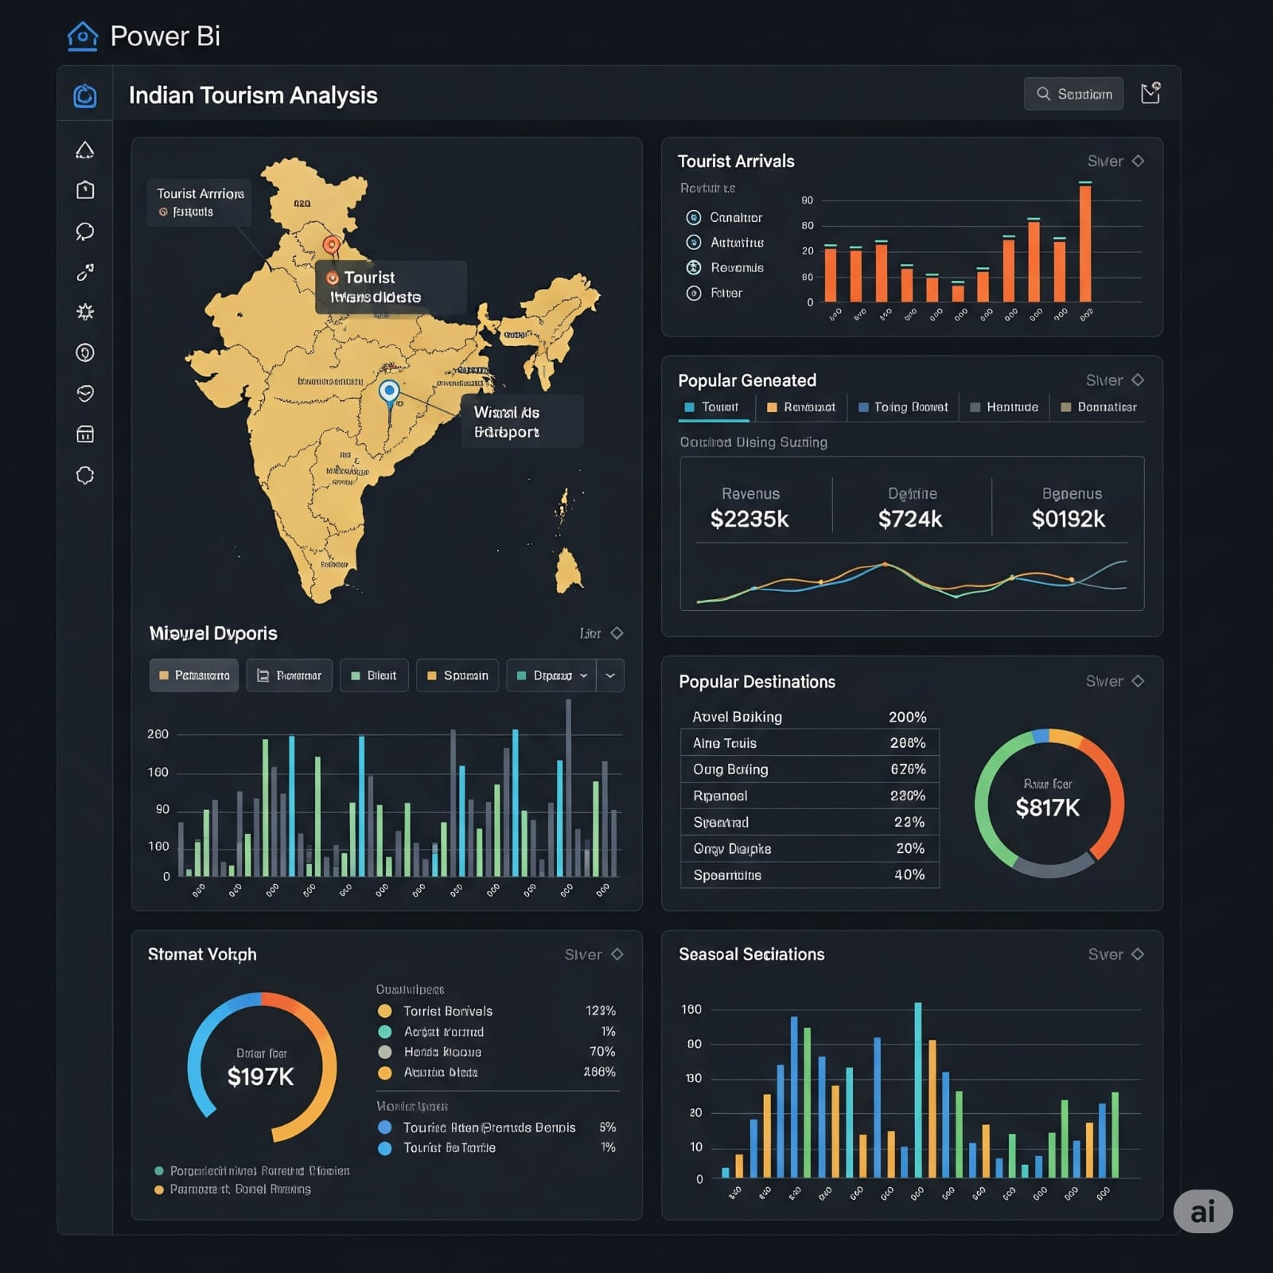
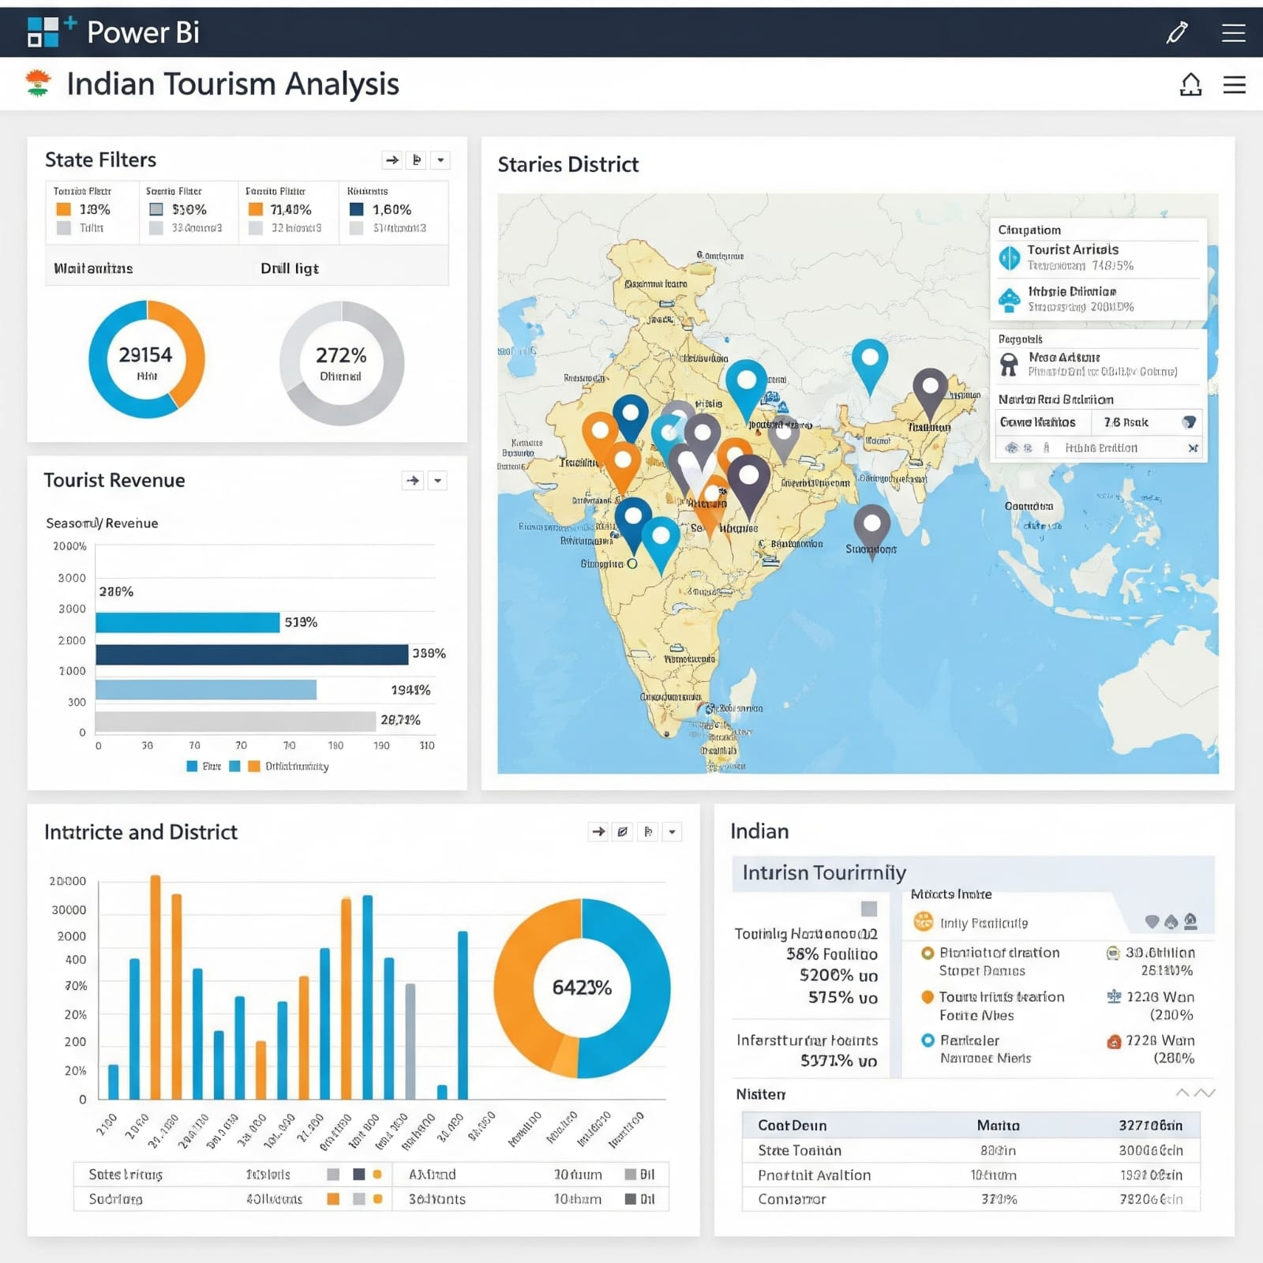
Power BI Dashboard – Overview
Page 1: Overview of tourists by year and month
Page 2: Activity and region-level analysis

Slide 15
Challenges Faced
Simulated data lacked consistency in timestamps
Geo-coordinates required normalization
Power BI limited to flat structures, requiring data reshaping
Final Outcomes
Built a cloud-based big data pipeline
Performed end-to-end EDA and visualization
Created an interactive and insightful tourism dashboard

Slide 16
Future Enhancements
Use real-time APIs like Twitter (Event Hub + Stream Analytics)
Perform sentiment analysis on tourist reviews
Integrate Power BI Embedded into websites

Slide 17
Conclusion
Successfully demonstrated end-to-end tourism analytics solution
Leveraged Azure & Power BI ecosystem
Provides actionable insights for tourism boards
Git :https://github.com/saiswaroopkakarla/Tourism-Trend-Analysis.git
Thank you

